Slide 1

Taxonomy & Rule Based Profile Mapping
Nick Allen
Technical Architect
Digital Consultant
Notes:
Working with Sitecore since 2007, four time technical MVP and have been a technical architect for about 5 years now working with agencies such as Valtech.
I am currently an independent technical architect and consultant for Think Fresh Studio.

Slide 2
Summary
What is profiling, why is it hard & why does it matter?
Theory of constraints & web optimization models
Sources of taxonomic information & meta data
Process item pipeline deep dive
Profile mapping demo!
Performance & statistics
The future (Sitecore 9.x)… and perhaps another demo!

Slide 3
What is Profiling?
Implicitly associating users (customers) with pre-defined audience characteristics based on their current AND historical behavior on and offline.
Using profile data to understand the impact that web optimization tactics are having on different groups of users.
Notes:
In one sentence?

Slide 4






Profiling – Why Does it Matter? Why Is It Hard?
Everything is not equal
  Content
  Users
  Products
  Product lines
  Conversions
Improving the user experience
  Relevance
  Efficiency
Next best conversation
  Bookmark
  Similar products
  Book
Requires up front investment of time, ongoing training / evangelism and maintenance
In addition to business as usual work
Organizations are finding their way through digital transformation and what it means to them
Organizations are busy fighting against competitors they never had before
Notes:
Why does it matter?
The web is not a one size fits all solution, web optimisation is about carving out the things that matter at an individual level.
CRM systems often talk about the next best conversation, profiling gets us a step closer to understanding more about the reason an individual is using our on (and offline channels)
Why is it hard?
Strategizing towards specific profiles and personas and being purposeful about that on a day to day basis is cultural change, it doesn’t happen overnight. If we can put the rules in the hands of a core team of engaged individuals and obfuscate the rest from wider internal teams the chances of success increase

Slide 5
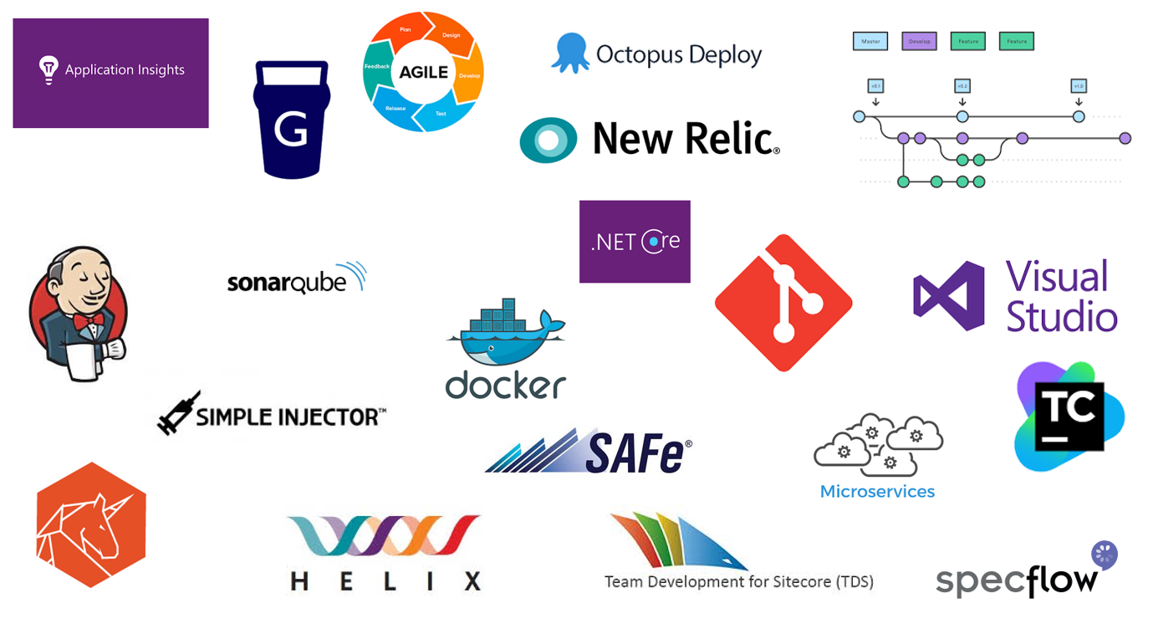
Theory of Constraints
“Every process has a single constraint and total process throughput can only be improved when the constraint is improved.”
Identify the constraint
Subordinate & synchronize to the constraint
Elevate the performance of the constraint
Exploit the constraint
Notes:
To expand on why it’s hard, we should consider the theory of constraints.
Explanation of the theory of constraints, why technical teams are good at continuous improvement (with examples) and the effect that has had on the marketing technology industry.
Technical teams are REALLY good at this!
Marketing and/or editorial teams (or any non-technical teams for that matter) are not so naturally good at continuous improvement
The biggest constraint on web optimisation for non-technical teams when it comes to web optimisation is the ongoing setup and maintenance of content tagging, personalisation tactics, A|B test etc. It’s a very hands on process and often now in addition to the day to day responsibilities that editorial and/or marketing teams have.

Slide 6
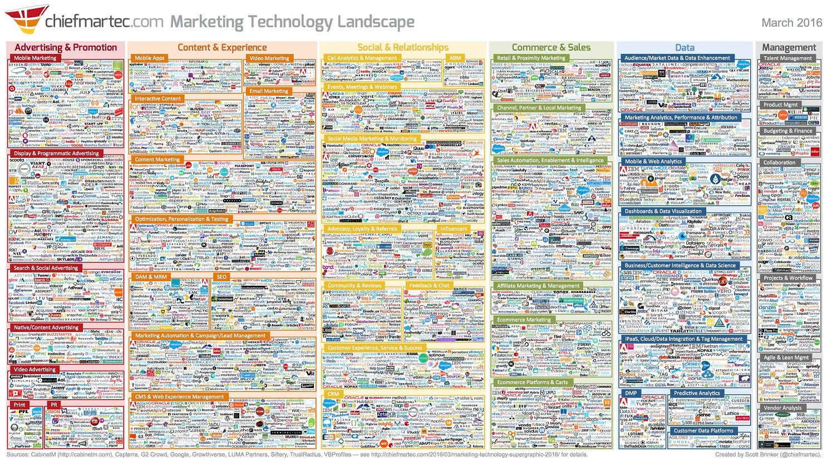
Notes:
Technical teams are really good at this, which is perhaps why we find ourselves in THIS situation, really smart people are solving problems, REALLY fast

Slide 7
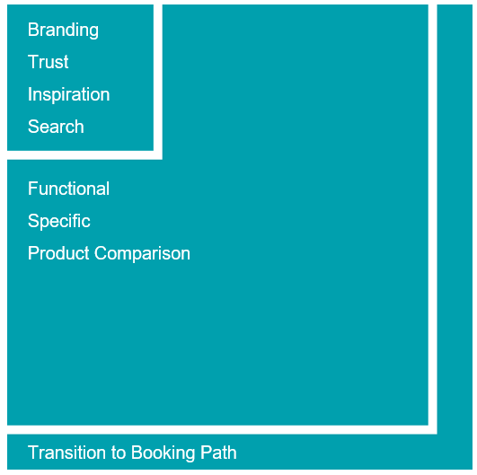
So how can technical teams help non-technical teams?
Web optimization models?
Zone a – top of the funnel, personalization
Zone b – Bulk of the site, automation
Zone c – End of the funnel, test
Profile mapping is an automation technique and creates data that serves as an input to personalization tactics in zone a.
Notes:
Explanation of the TOM model, with the key part (and the topic for today being the automation piece in Zone B).
Zone A represents the top levels of your information architecture e.g. the home page, landing pages etc. The content on these pages tends to be reasonably generic as you entice your visitors to get deeper into the site based on their preferences
Zone A represents a volume of pages that your content team(s) can manage on a day to day basis. It is yet to be established what this number is. 500? 1000?
Zone B represents a volume of pages that your content team(s) cannot realistically manage manually, this is where profile mapping can really help
Profile mapping uses taxonomic information and meta data that already exists in your site and it’s content to automate the process of implicitly profiling your site visitors.
This is just one example of a web optimisation model for sites that are hierarchical in nature, your site may not fit this model, it may have a very flat structure and it’s more about the product information and it’s properties that defines priorities or zones, the point is find a model that works for you and enables teams to break the problem down and experiment.

Slide 8
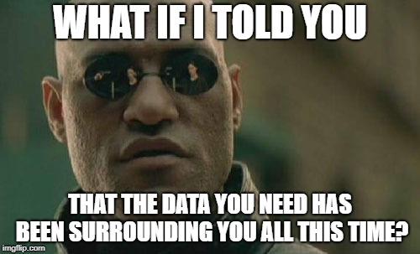
But where does the data come from?
Notes:
If we’re not manually tagging content to decide which audiences our content is targeting, then where is the data coming from to be able to automatically make that decision?

Slide 9
Sources of taxonomic information & meta data
Taxonomic information
Information architecture
  Path
  Parent
  Level
Controlled vocabulary
  Hierarchy
  Relationships
Meta data
Product information
  Price
  Tags
Content attributes
  Statistics
  Template
Session
  Page views
  Duration
Entity extraction (more on this later)
Notes:
A taxonomy is typically a controlled vocabulary with a hierarchical structure, with the understanding that there are different definitions of a hierarchy. Terms within a taxonomy have relations to other terms within the taxonomy. These are typically: parent/broader term, child/narrower term, or often both if the term is at mid-level within a hierarchy.
Controlled vocabulary may for many sites mean the same thing as the information architecture in the sense that a controlled vocabulary can be represented by a hierarchical tree of nodes. But for some you may have access to a deeper controlled vocabulary that is used to tag content to drive things like faceted search.
Session information (in our case the tracker) is data about data in the sense that it enriches the context in which content is being viewed and can be taken into account when profiling, for example if the user has viewed a piece of content more than x number of times in the visit that may indicate a strong interest that warrants mapping to a profile
Entity extraction, automatically find people, places, products and organizations in text.

Slide 10
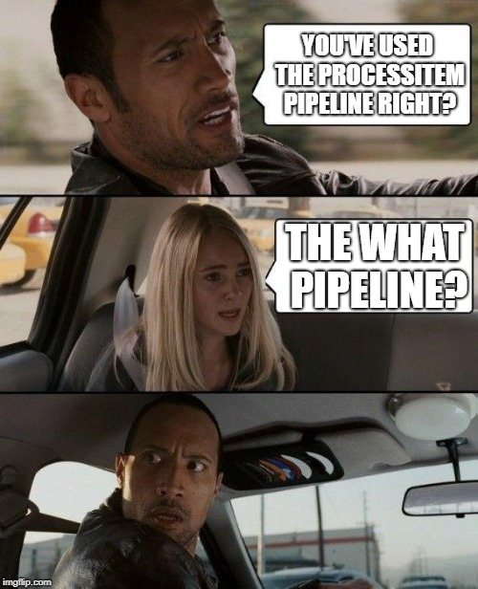
How can we use this meta data?
Process. Item. Pipeline.
Notes:
The magic happens in the process item pipeline, we can unobtrusively, and by that I mean not prevent manual tagging and without deep customisation, extend this pipeline using concepts and properties that already exist in the pipeline args.

Slide 11
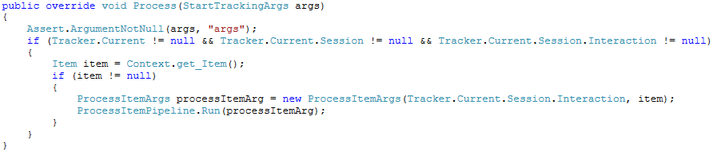
Process item pipeline
Sitecore.Analytics.Tracking.config
<startTracking>
  ProcessItem
    Validates Session
    Instantiates Args
Sitecore.Analytics.config
<processItem>
  CollectParameters
  TriggerCampaigns
  RegisterPageEvents
  ProcessProfiles
Notes:
The validation of the session here means you can afford to be less defensive in any additional processors you add to the processItem pipeline and you have direct access to the current interaction in your pipeline processor…. Which is nice.

Slide 12
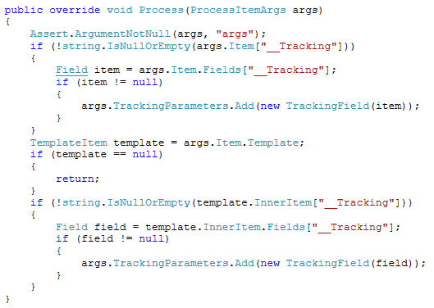
Process item pipeline contd.
CollectParameters
Create a new instance of TrackingField if it is populated on the context item or its template
Add the TrackingField to the TrackingParameters collection property on the ProcessItemArgs passed into the processor
Notes:
The really key point here is that the TrackingParameters property is a collection that we are free to add to within the processItem pipeline. We’re going to cover this when we look at the extension to the processItem pipeline for profile mapping

Slide 13
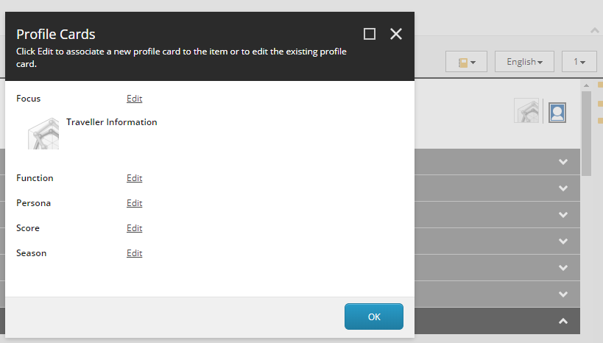
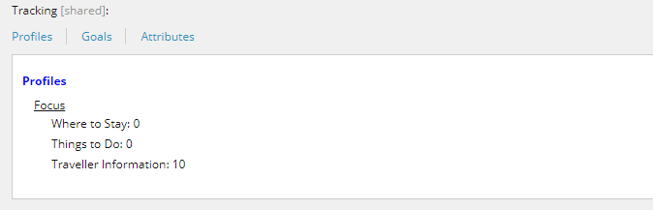
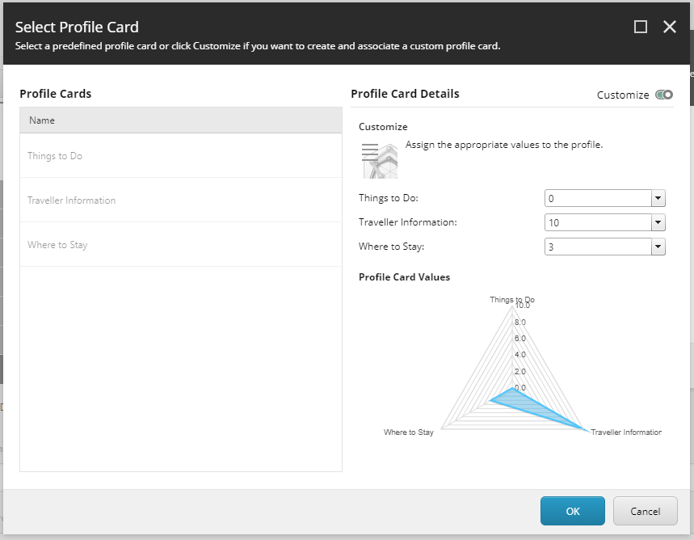
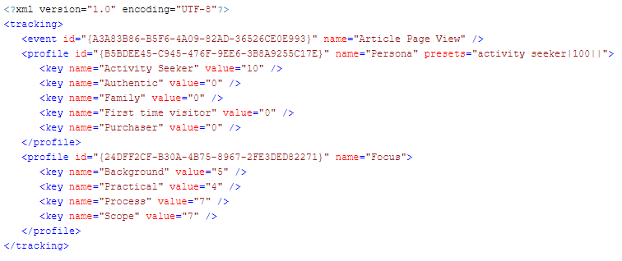
Tracking field (__Tracking) sample

Slide 14
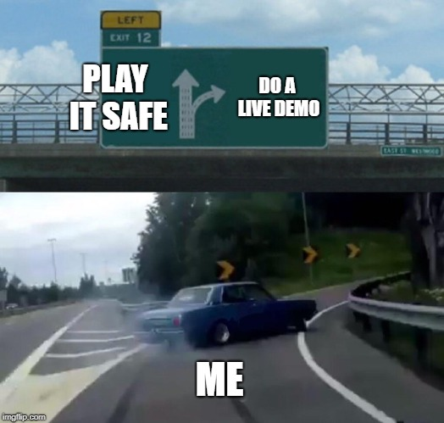
Demo
Notes:
How does this all come together, setup profile map items + code overview
Set up of profile items, 1 to 1 profiles vs. ranges. Show scaffolding (not anymore) utility to auto create profile and pattern cards with key creation
Profile map configuration items.
Profile map source code overview i.e. teh codez.
Take a look at the template structure to see how simple it is to add new types of mapping items, three types included by default
Descendant of maps
Reference maps
Range maps
Date range maps
Field contains maps

Slide 15
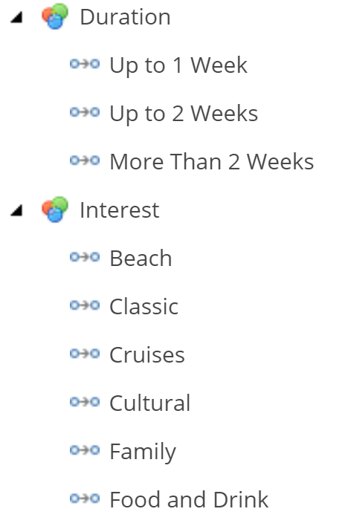
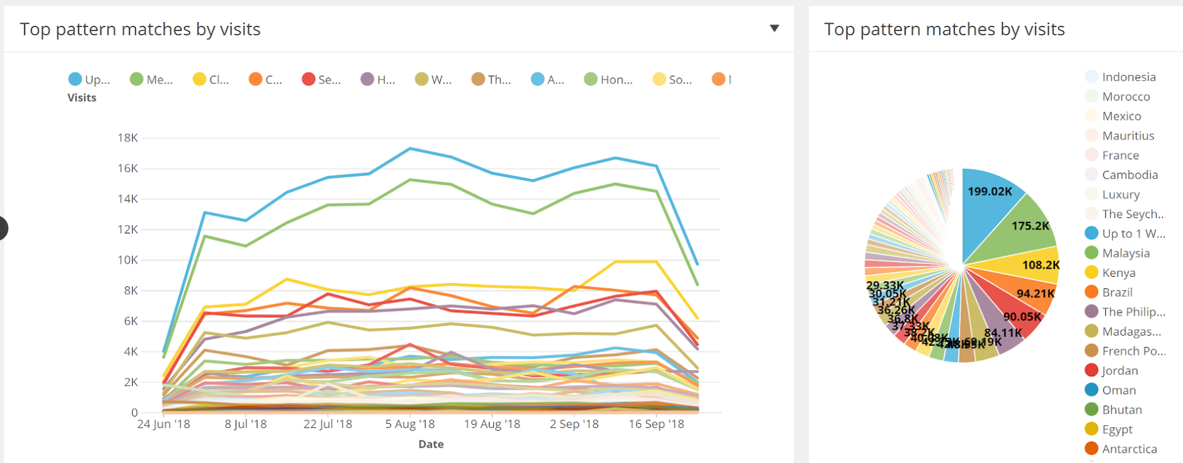
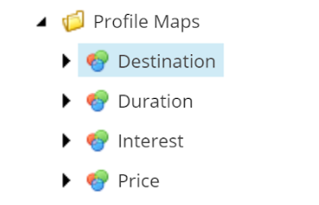
Performance & statistics
Performance
Custom index and content search API (Map Repository)
CustomCache after retrieval with interval based eviction due to low volatility
Statistics
http://www.audleytravel.com
1.7m – 2m page views per month
50+ profile maps
No negative impact
Notes:
Plan for growth.
All sites are different, you should test at representative loads with profile mapping enabled before going to production

Slide 16
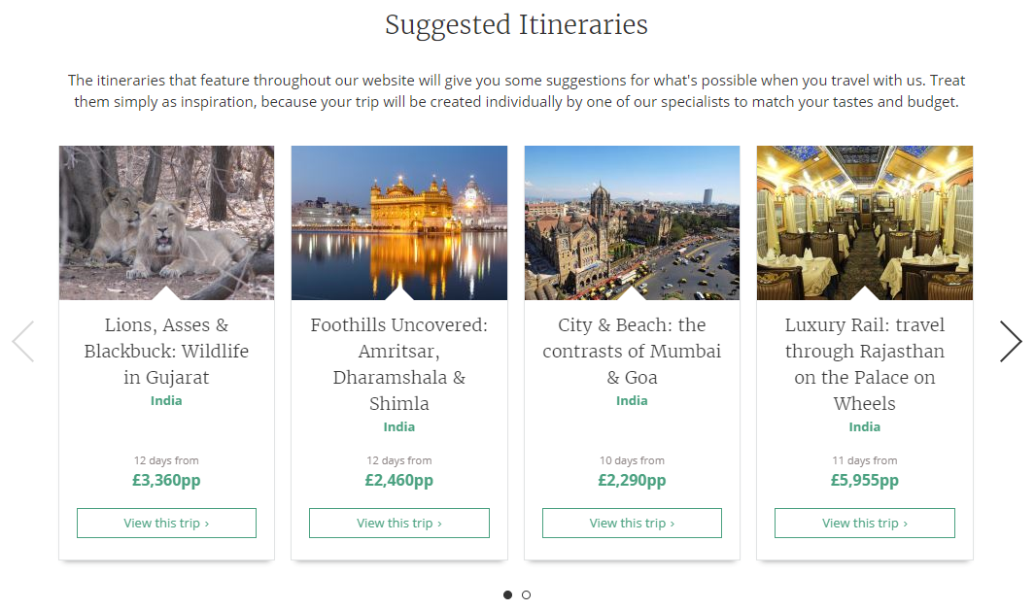
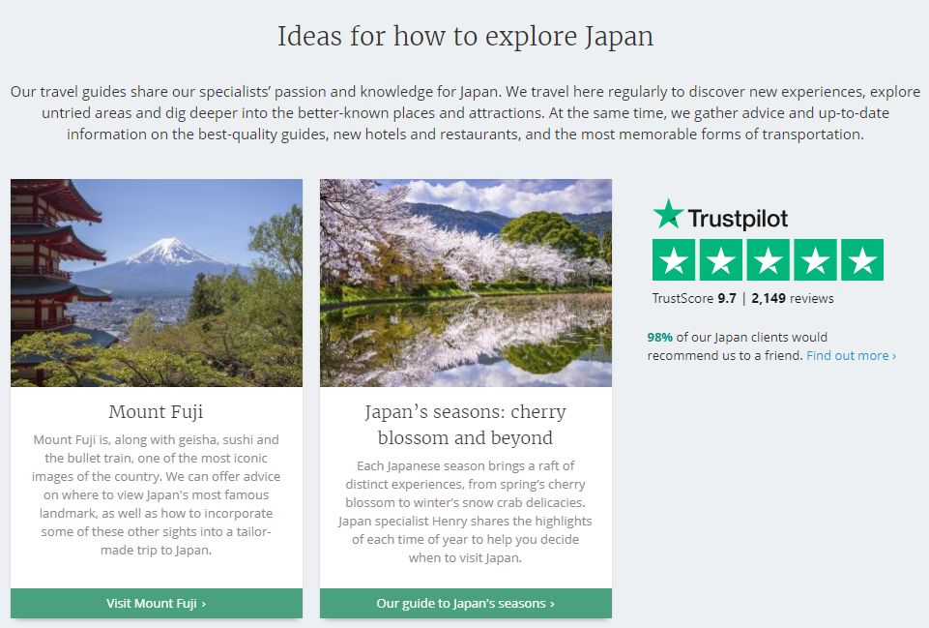
Personalization Use Cases
Suggest itineraries based on the users interest, price range and duration.
Suggest travel guides by interest.

Slide 17




The future
Integrate with cloud solutions for enhanced meta data mining.

Slide 18
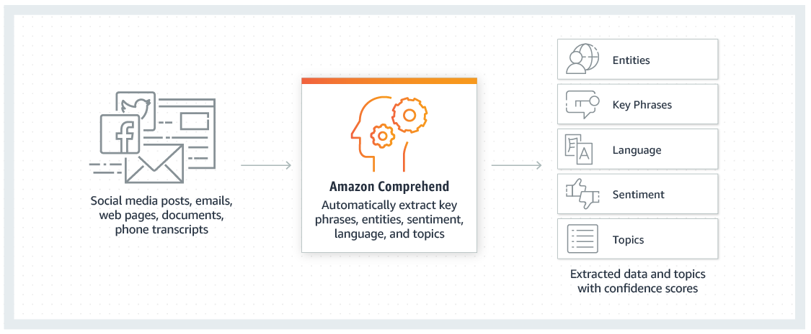
The future – Amazon Comprehend
Comprehend
Entities
Key Phrases
Sentiment
Topics

Slide 19
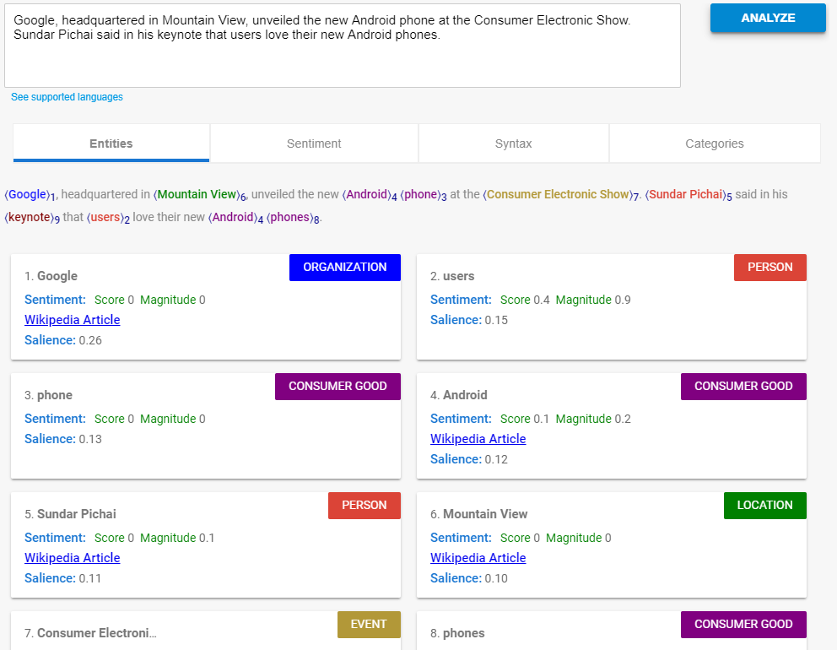
The future – Google Cloud natural language
Natural Language
Extract information
Understand sentiment
Parse intent
Topics

Slide 20
Sitecore Cortex – content tagging
  Sitecore Cortex automates the task of content tagging for both internal and external search.
  Integration with Open Calais comes with an out-of-the-box taxonomy. You do not need to train your own model!
Content tagging creates information taxonomies used to provide better SEO rankings, content experiences and search results on your website.
Sitecore Cortex uses a configurable provider framework for content tagging which allows you to bring your own Natural Language Provider.
Notes:
Sitecore 9.1 comes with Content Tagging out-of-the-box.
The provider framework put in place here is configurable. You get OpenCalais as your default content tagging option, but it has been setup to allow you to customize with your own Natural Language Provider.
As an option, Open Calais does have some benefits and downsides
PRO: Comes with its own set of taxonomy so easier to ‘switch on’ OOTB. You don’t have to train a model and build your own taxonomy, so this is great for teams getting started.
CONS: This benefit is also a downside as it means you can’t bring your own taxonomy in. Open Calais also has limited multilingual support, and is best with English.

Slide 21
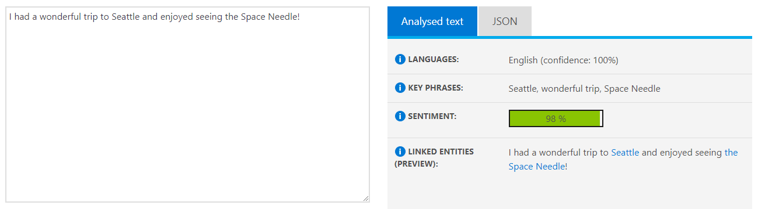
The future – Azure Cognitive Services / Text Analysis
Text Analysis
Key phrase extraction
Entity linking
Sentiment analysis

Slide 22
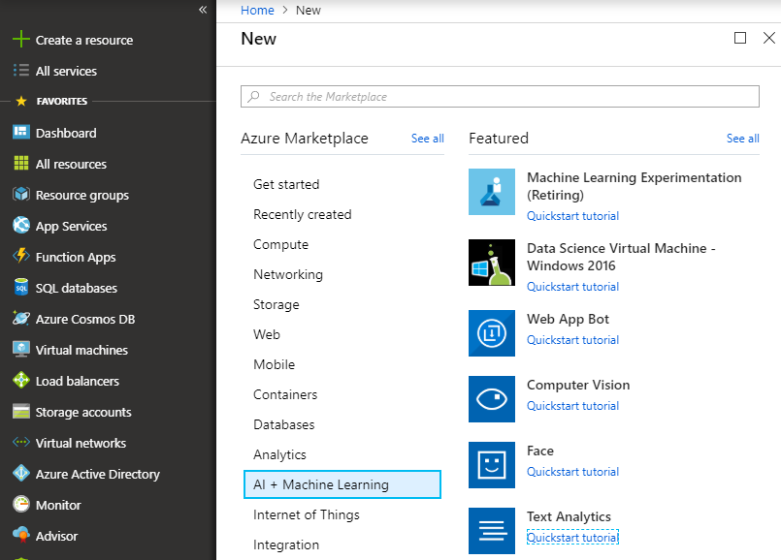
The future – Azure Cognitive Services / Text Analysis
Key phrase extraction
  Works best with big chunks of text. Combine text from page item fields and component fields (API supports sending multiple “documents” for text analysis, consider a component a document)
  Up to 1000 documents can be sent in a single call
  You do need to send as plain text so strip out tags before sending for analysis
Entity linking
  Disambiguates recognized entities, which requiresa knowledge base, Azure uses Wikipedia
Sentiment analysis
  Most use cases surround UGC but could be used to QA internal copy

Slide 23
Demo
Notes:
- Content tagging on demand
- Content tagging on publish

Slide 24

nick@thinkfreshstudio.com
http://sitecorecreative.wordpress.com
@sitecoretweet
https://github.com/thinkfreshnick/Sitecore.Feature.ProfileMapper

